Slide 1
Siege Defence

Slide 2
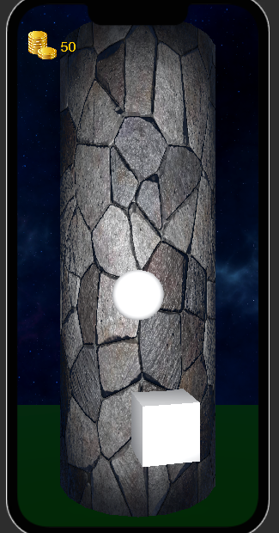
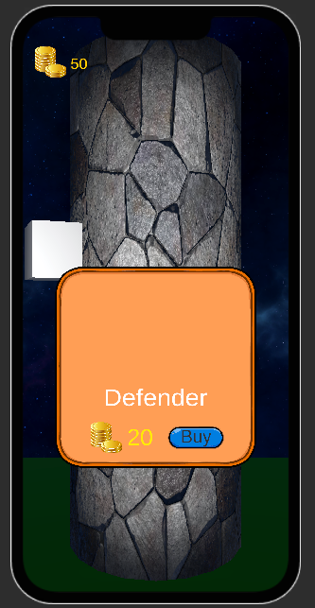
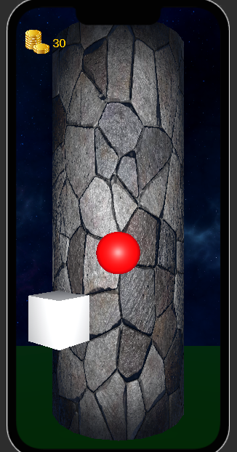

Slide 3
features
Touch screen controls swipe to move camera, tap to buy defenders
The phone will vibrate when enemies reach the top
Accelerometer, There will be an energy bar when full, the player can shake the screen, to shake enemies off the tower

Slide 4
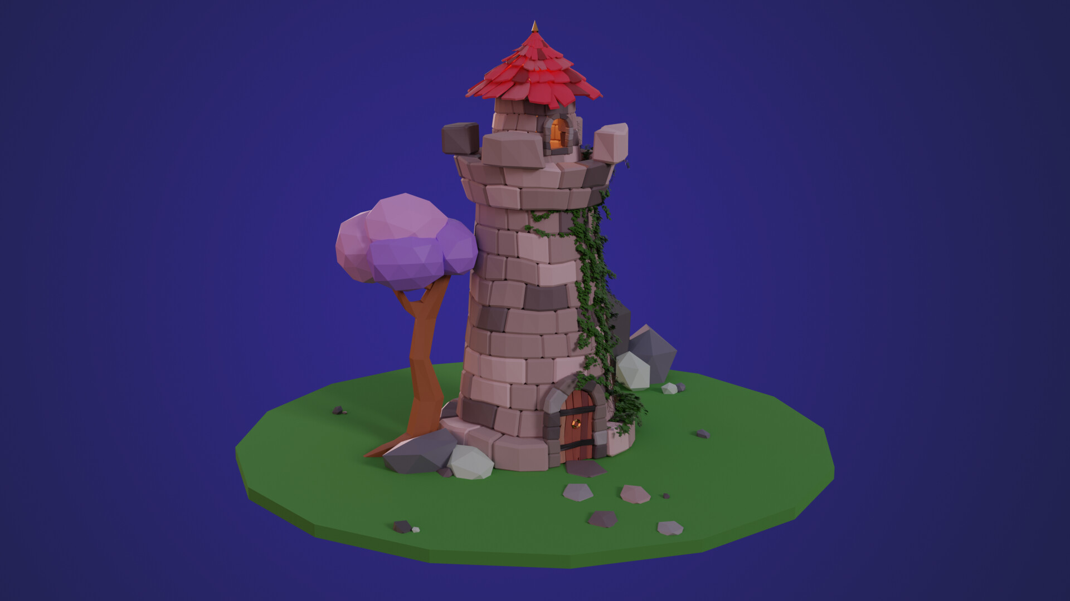

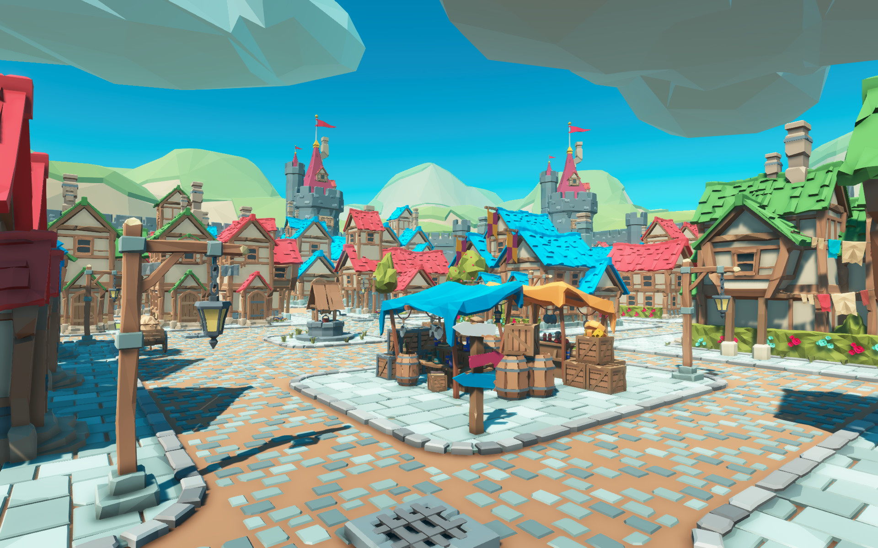
Art Style

Slide 5
Rationale
Tower Defence is a popular but saturated genre
This project aims to be a unique take on the genre, in order to shake up the market

